Slide 1


Sentiment Analysis In Marketing: Negative Review Detection In Product Reviews
Supervisor : Maxime AMBLARD
Students : Aine DRELINGYTE, Axelle GAPIN, Danyl SHKREBKO, Elie DINA, Joseph JREIJE, Omar ABEDELKADER, Quentin HERBIN

Slide 2
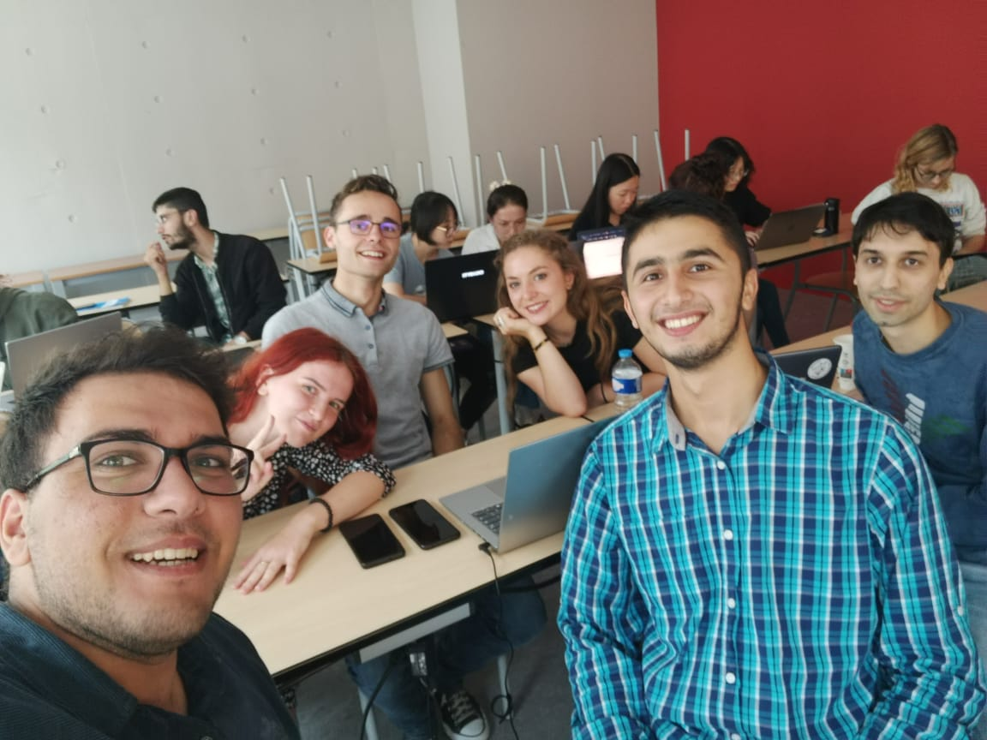
Introduction
Individuals’ opinions and perspectives are an important medium for marketing purposes, however, currently there is a lack of tools to allow us to process the abundance of data.
The project will focus specifically on customer reviews.

Slide 3

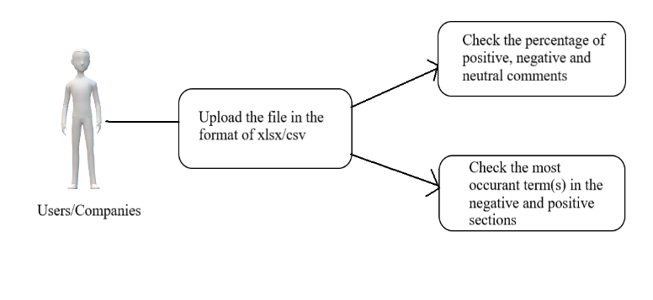
Final Product And Goals

Slide 4
Team Roles Methods
Our team is composed of 7 members:
3 Linguists
2 Data Scientists
2 Computer Scientists
Corpus Creation
Data Cleaning.
Corpus annotation.
Pre-processing
Classification Models
Final Testing
Conclusion & Final Status

Slide 5


